Slide 1

Course Project - System Design and Implementation
Sahil lnu, Amani Mulaudzi, Angela Mast and Marina Perdiguero

Slide 2
Executive Summary
The Workers’ Compensation Division struggles with a slow, outdated paper-based filing system.
Searching and adding new claims is time-consuming, creates storage issues, and frustrates both clerks and claimants.
A digital case management system would dramatically improve processing speed, accessibility, and overall efficiency.
The new system would reduce labor costs, improve customer service, and save the department significant time and money.

Slide 3
Feasibility Analysis - Technical
Limited Experience: Team unfamiliarity with digital systems requires new processes and training.
Technology Gaps: Advanced tools (databases, web apps) may exceed current team skills. Mitigation: Hire IT experts or vendors.
Large Scope & Complexity: Secure platform, database integration, and record digitization increase risks. Mitigation: Use phased rollout, clear milestones, and progress reviews.
System Compatibility: Challenges with migrating data and ensuring compliance (HIPAA). Mitigation: Careful planning, secure access controls, and regulatory checks.

Slide 4
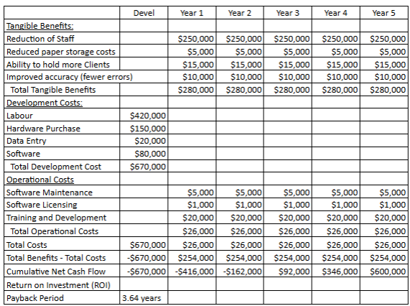
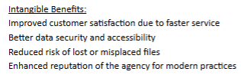
Feasibility Analysis - Economic

Slide 5
Feasibility Analysis - Organizational
Strategic Alignment
Supports South Dakota Dept. of Labor’s goals.
Replaces outdated paper system for faster, fairer claims handling.
Project Champions
Key leaders drive change, secure resources, and manage resistance.
Senior Management
Approves resources and reinforces project importance.
Users
Clerks/admin staff gain efficiency and time savings.
User input ensures system usability and high adoption.
Benefits
Long-term cost savings, operational efficiency, and improved service.

Slide 6
Key Business Requirements
User Requirements:
Secure, searchable database for claim records by name, address, or injury date.
Online submission of injury reports, real-time claim status updates, and role-based secure access.
HIPAA compliance and 5% annual data growth capacity.
System Requirements:
Database: Relational (MySQL/PostgreSQL), full-text search, scalable storage.
Interface: Intuitive, accessible, multilingual, cross-platform.
Integration: File uploads in multiple formats, secure healthcare system APIs, upload timestamps.
Compliance: HIPAA and all legal standards, with flexibility for future regulations.

Slide 7
Key Business Requirements
Functional Requirements:
Process-Oriented: Upload multiple file formats, integrate medical records, and track upload dates.
Information-Oriented: Support 20,000 files + 5% yearly growth, archive inactive files after 6 years, and categorize by document type and date.
Nonfunctional Requirements:
Operational: Compatible with existing systems, easy for clerks and medical staff, cross-platform/browser support.
Performance: 24/7 availability (except maintenance), 600 concurrent users, 5-second data retrieval.
Security: Activity logs, role-based access, encrypted backups, daily backups, 2-hour recovery plan, multi-factor authentication.
Cultural/Political: Multilingual support, compliance with federal/state laws, easy updates for legal changes.

Slide 8
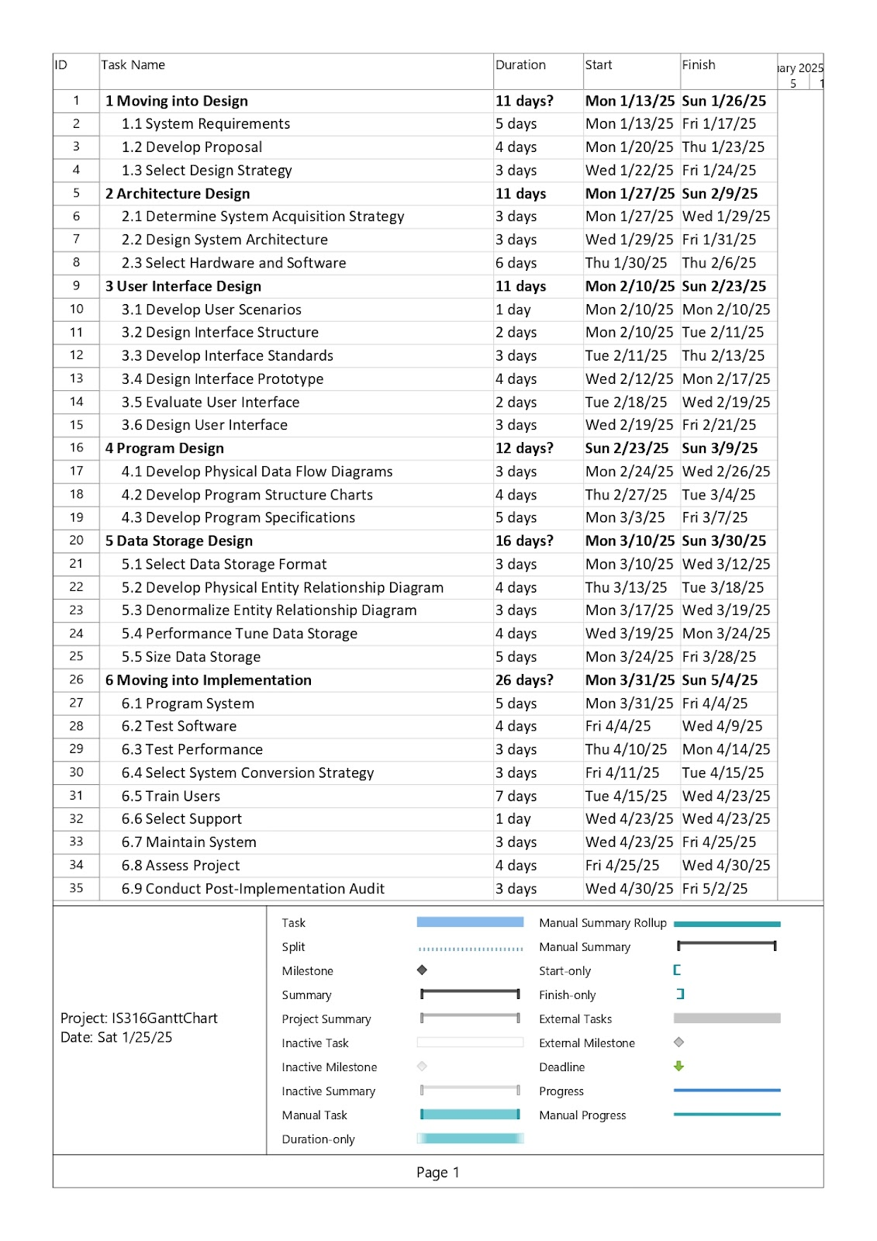
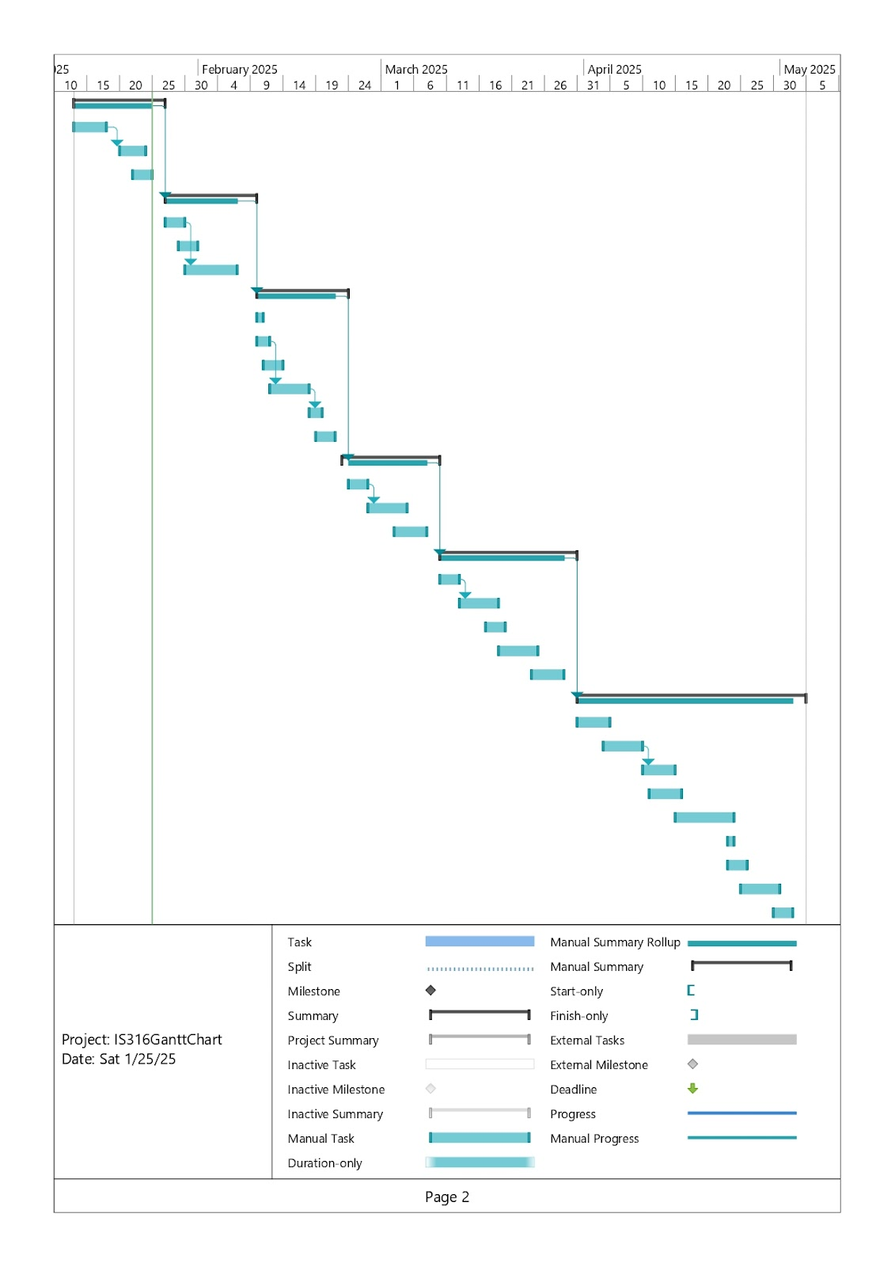
Project WorkPlan

Slide 9
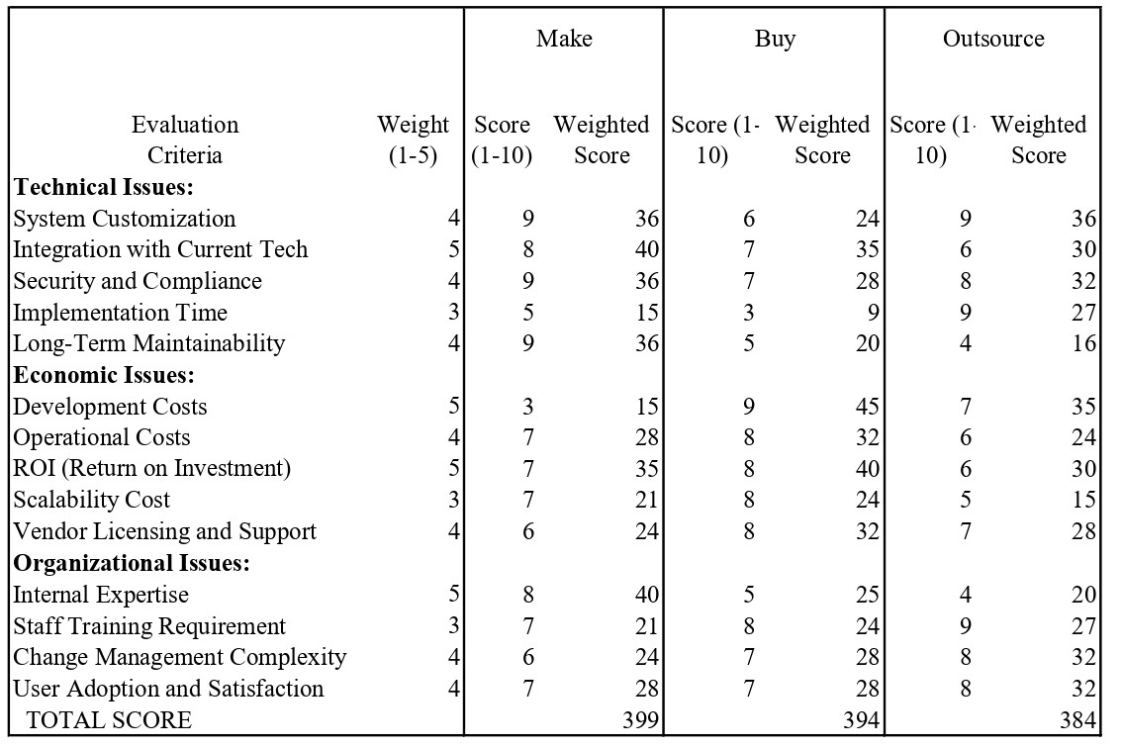
Acquisition Strategy

Slide 10
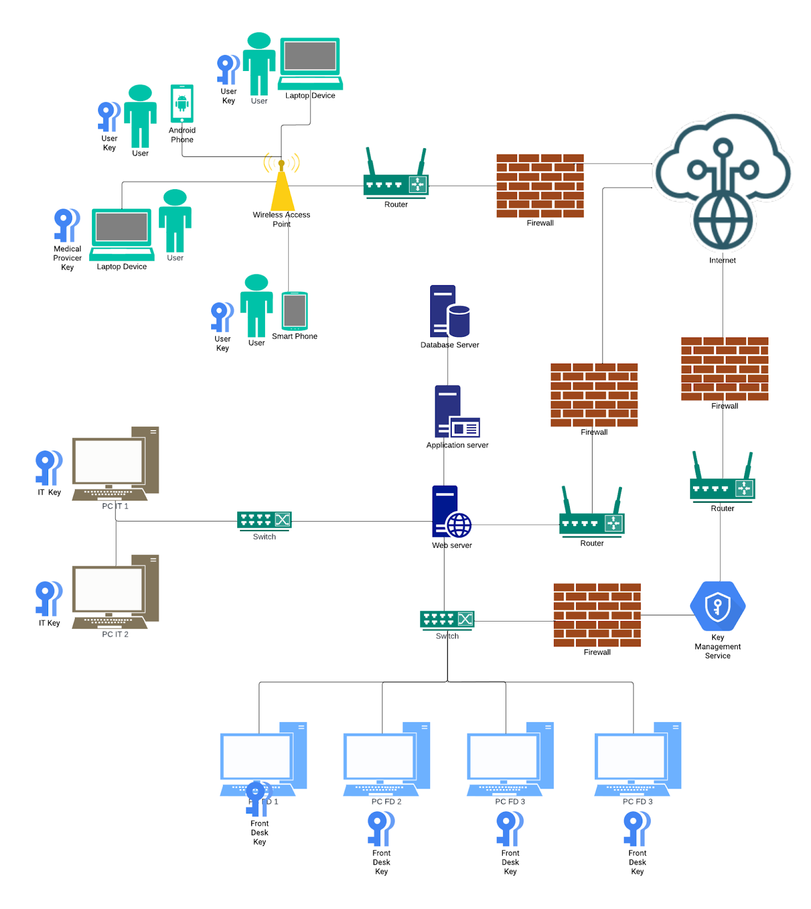
System Architecture

Slide 11
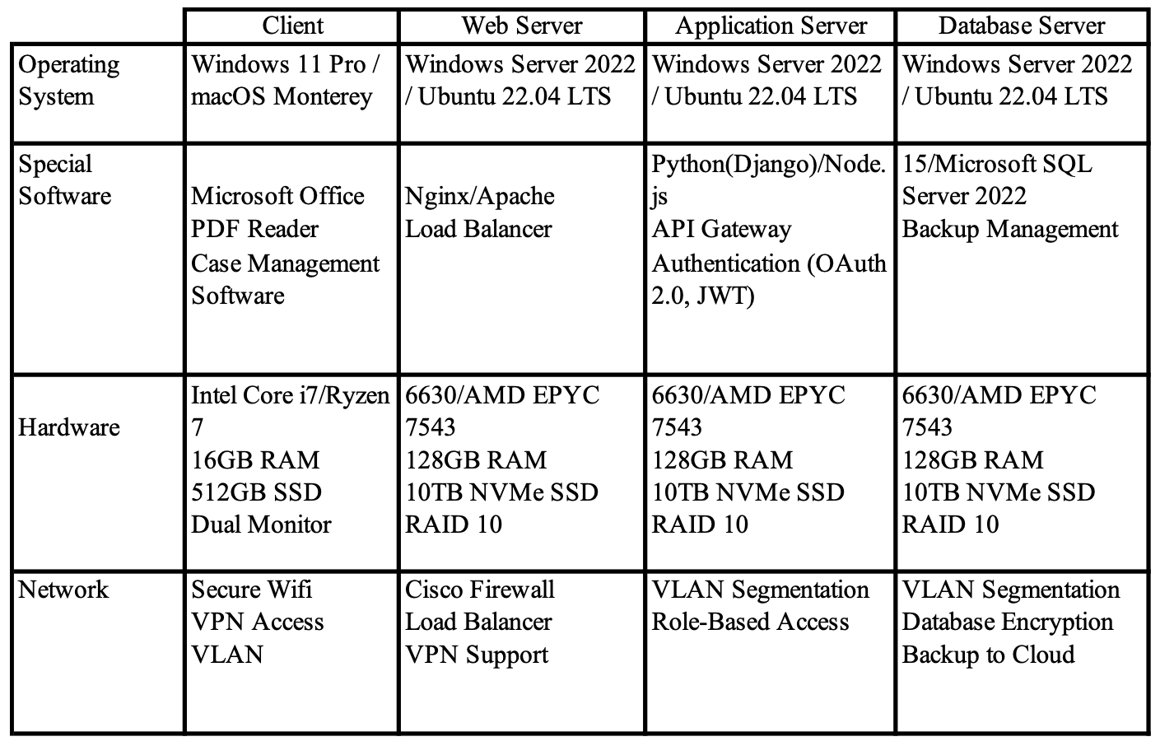
Hardware and Software Specifications

Slide 12
User Personas
 | Front Desk | Employee | Medical Provider
Knowledge | Basic case intake, documentation, and appointment scheduling but not technical | Limited understanding of workers' compensation processes but expects clear guidance and updates. | Understands medical evaluation processes and required documentation
Tasks | Receives and logs new cases, updates case statuses, schedules, and communicates. | Submits claims, provides necessary documents, attends medical evaluations, and follows up on case status. | Conducts evaluations, submits medical reports, and communicates findings
Interests | User-friendly interface | Timely updates, clear instructions, and an easy way to submit and track claims. | Wants streamlined access to case details
Characteristics | Organized, detail-oriented, and focused on multitasking, easy-to-use tools | Practical, concerned about timelines, and values transparency in case processing. | Precise, time-conscious, and values accurate communication

Slide 13
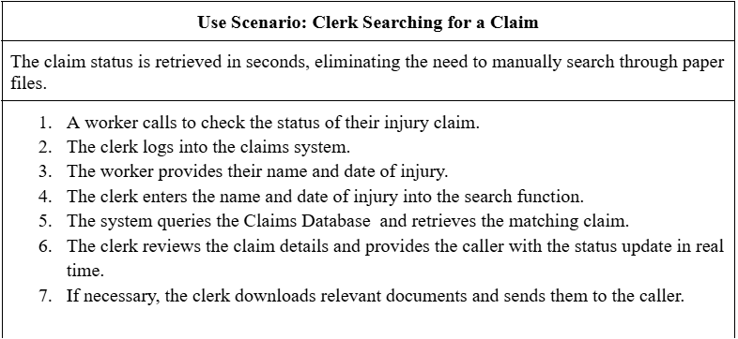
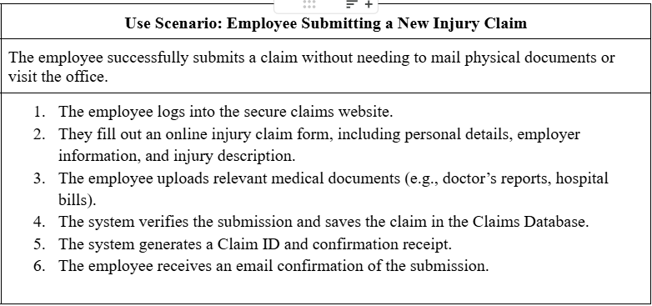
Use Scenarios

Slide 14

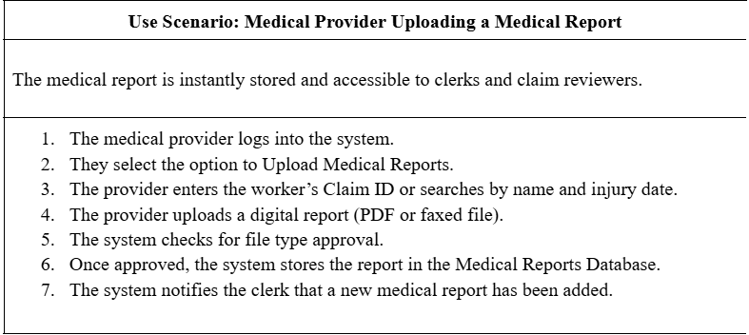
Use Scenarios

Slide 15
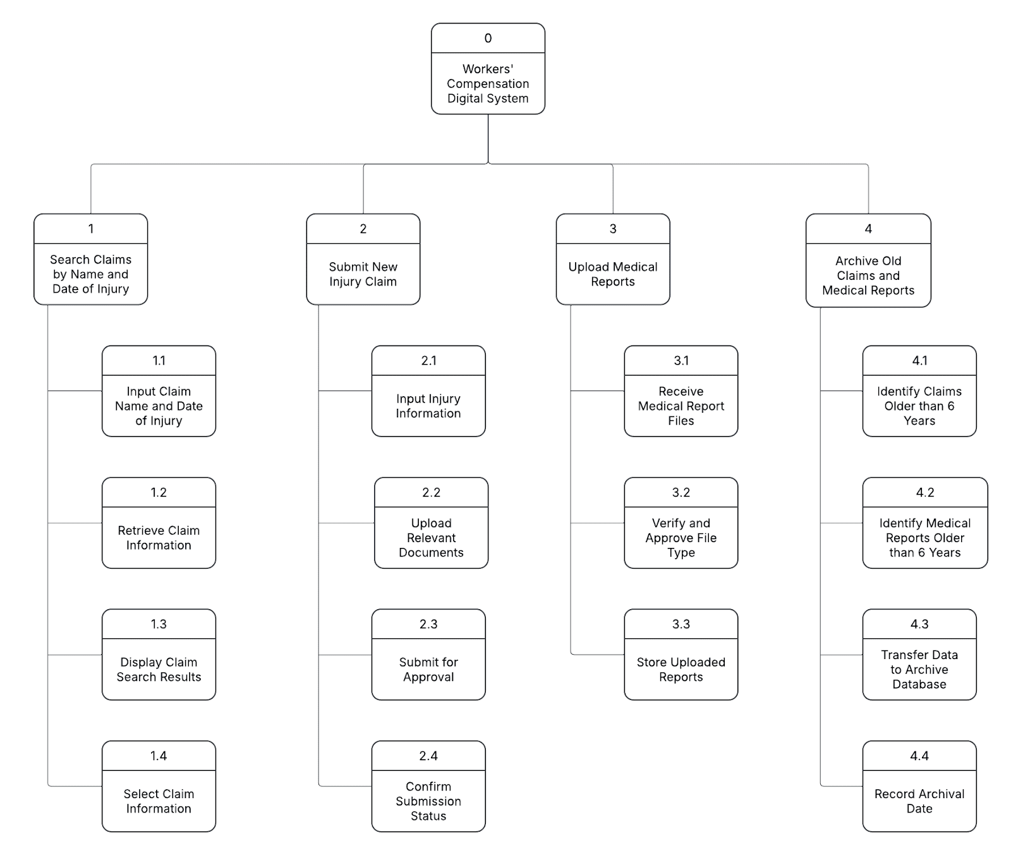
Interface Structure Diagram

Slide 16
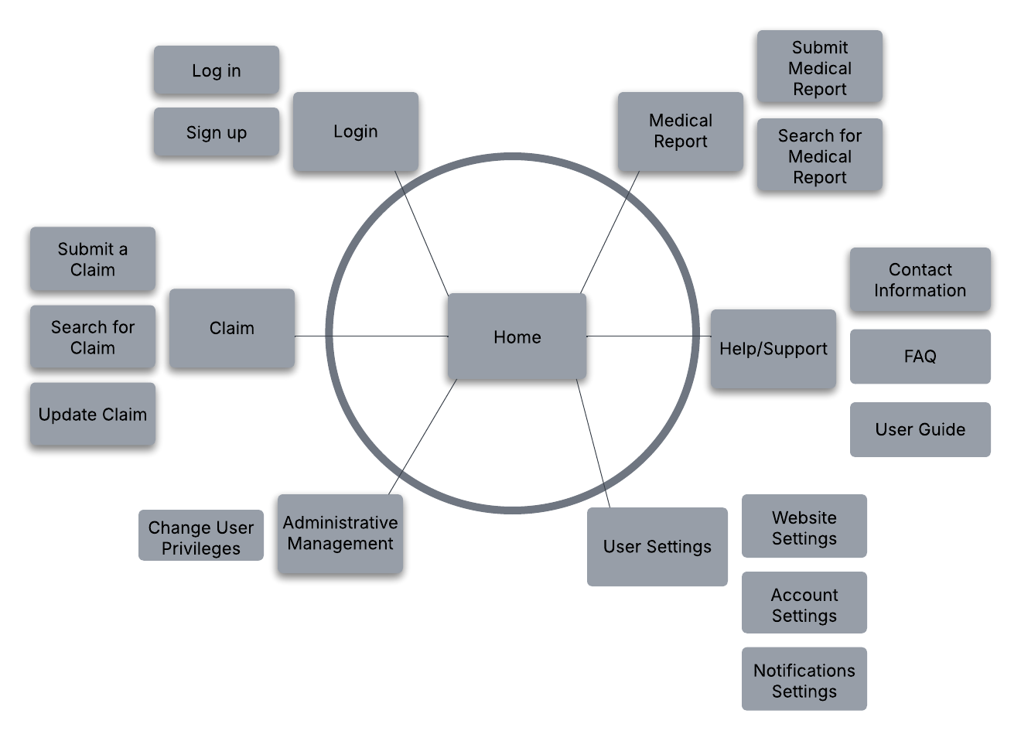
Site map

Slide 17
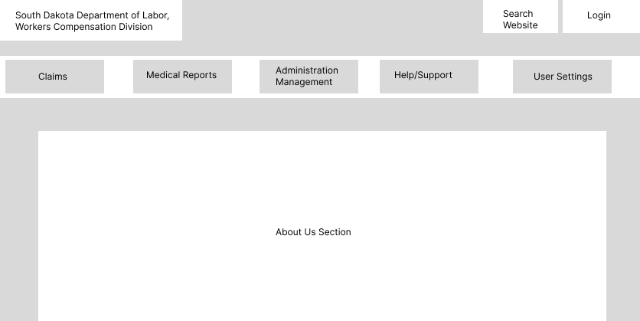
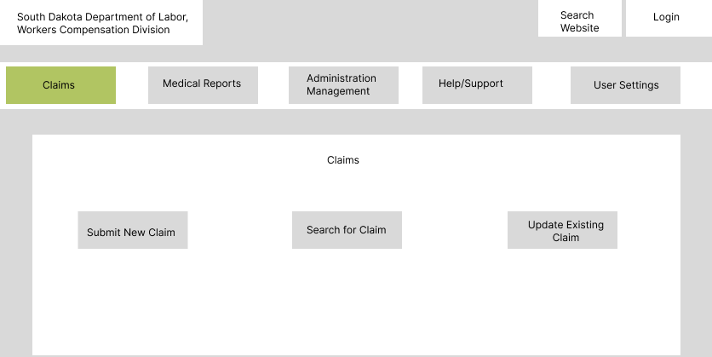
Monitor Screen Layouts
Home Page
Claims Page

Slide 18
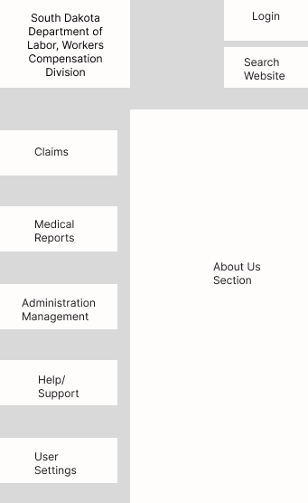
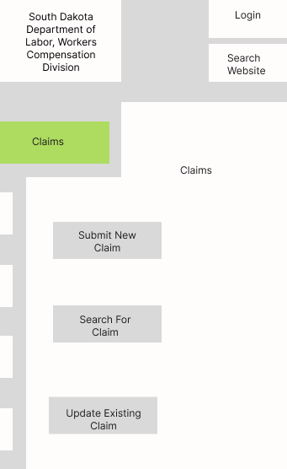
Mobile Device Screen Layouts
Home Page
Claims Page

Slide 19
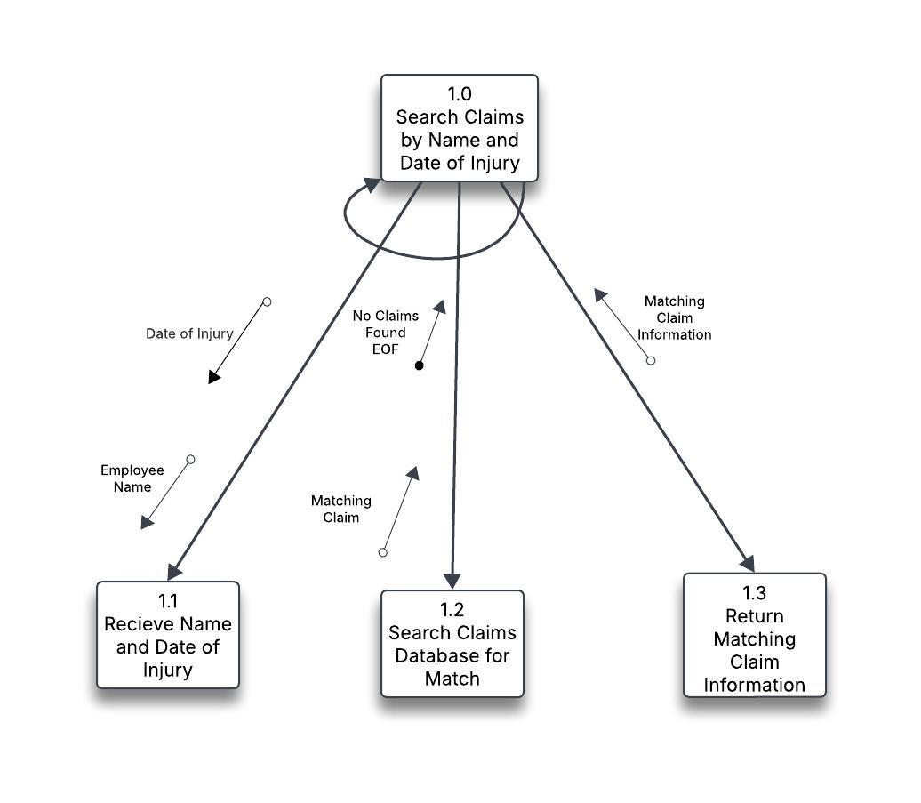
Structure Charts

Slide 20
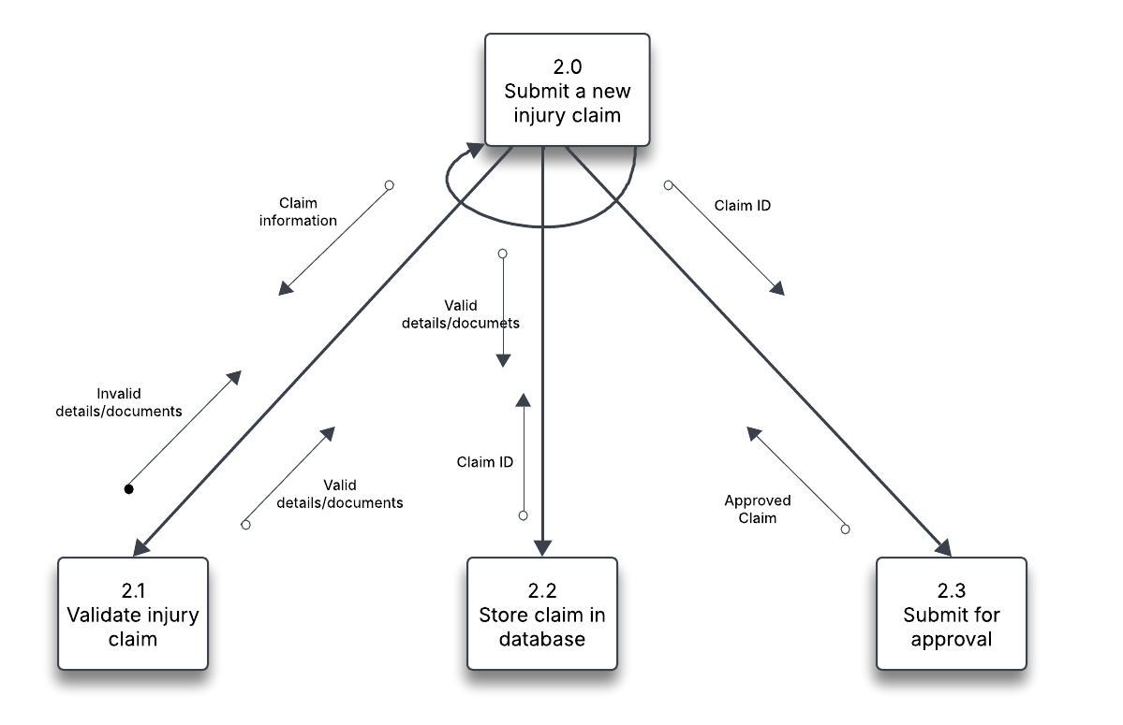

Slide 21
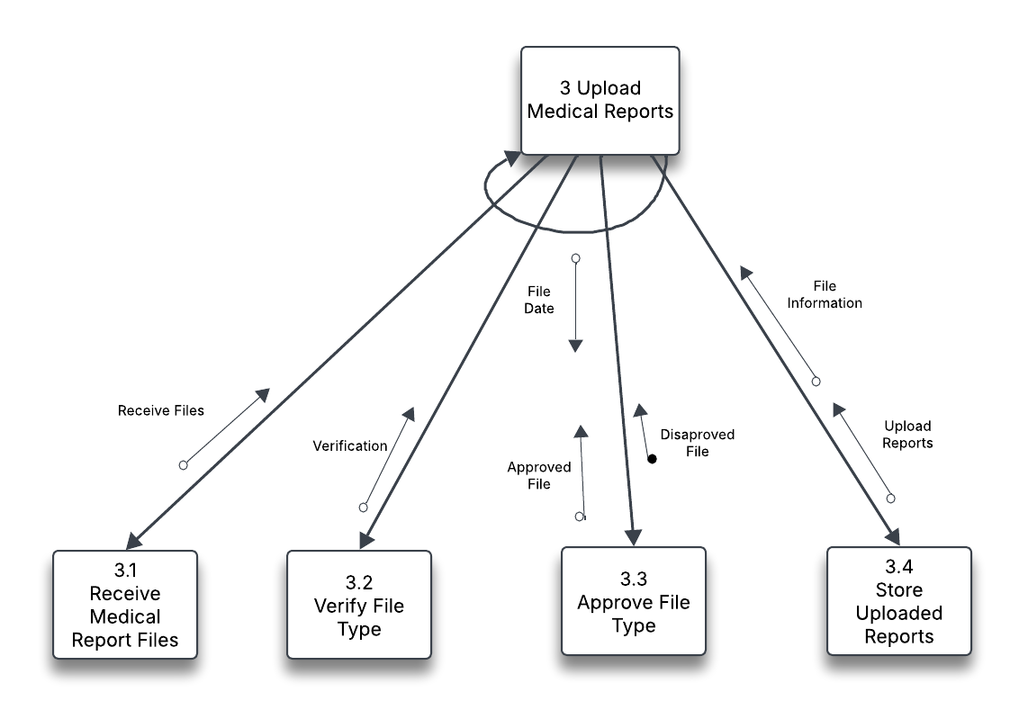

Slide 22
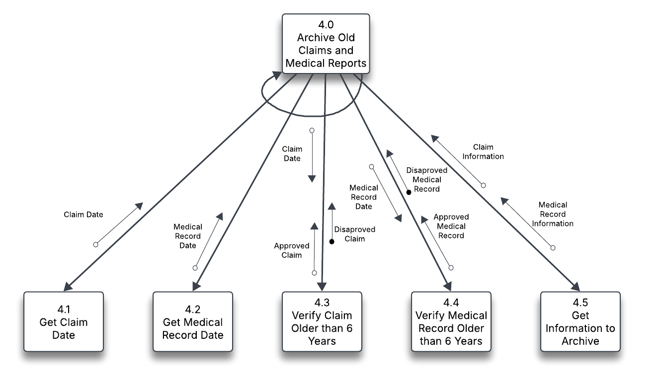

Slide 23
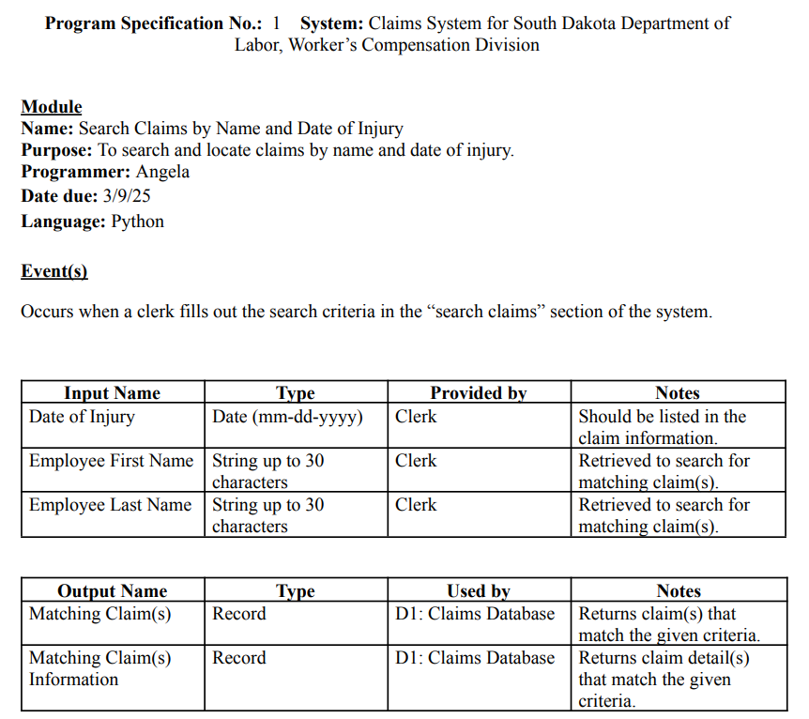
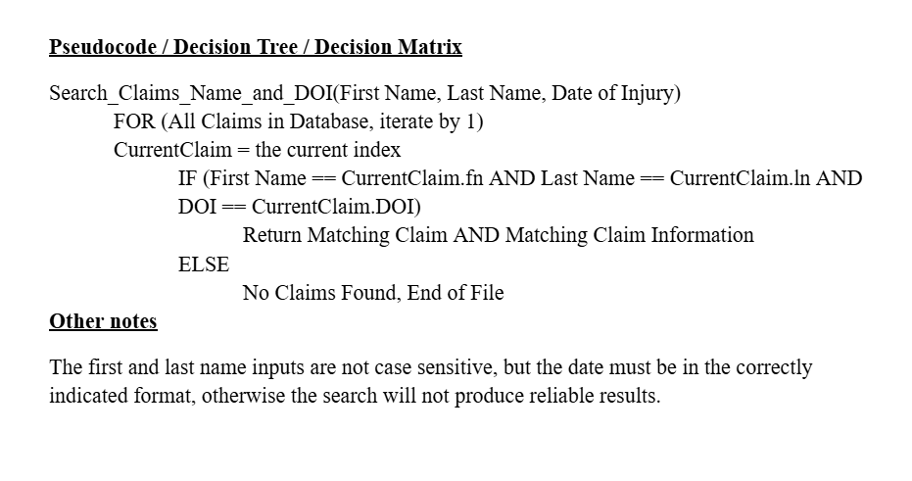
Programs Specifications

Slide 24
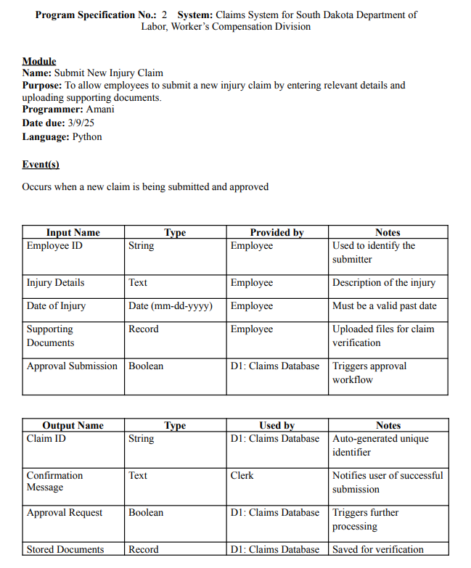
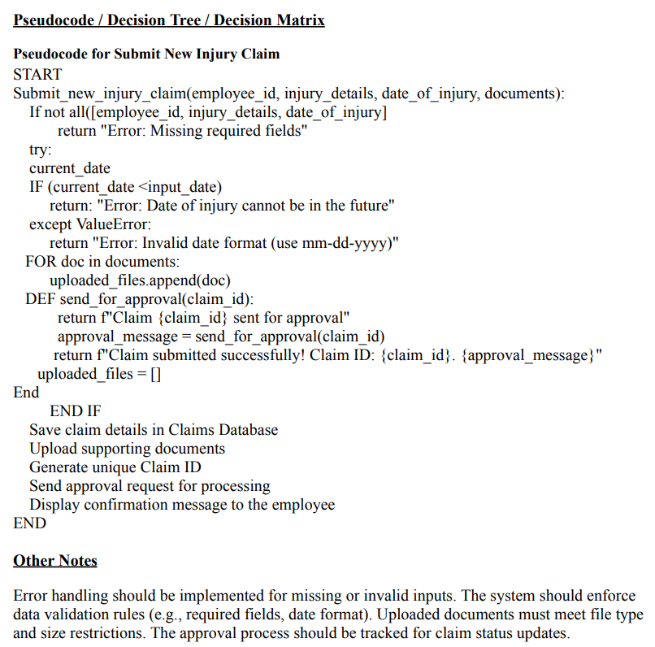

Slide 25
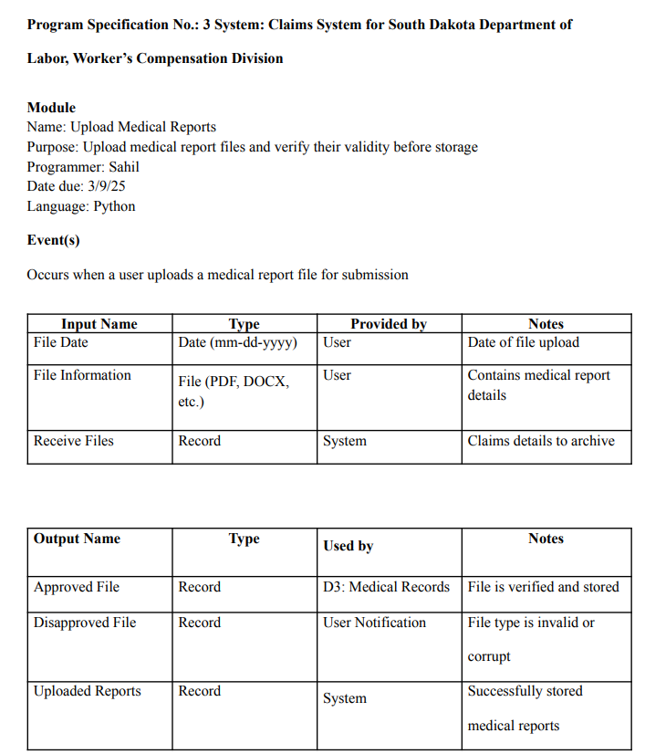
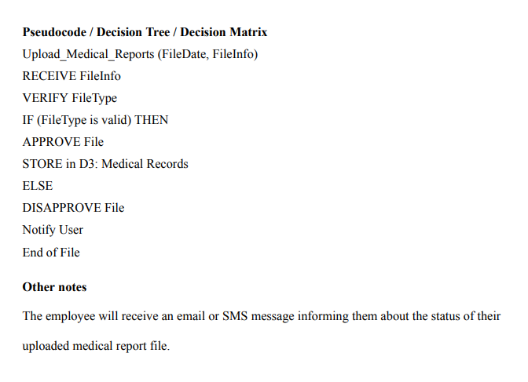

Slide 26
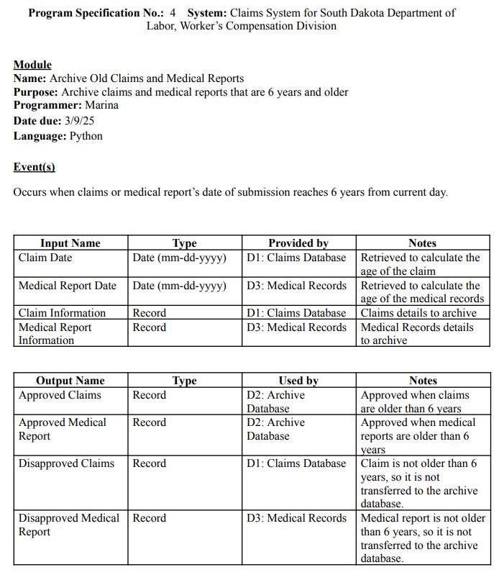
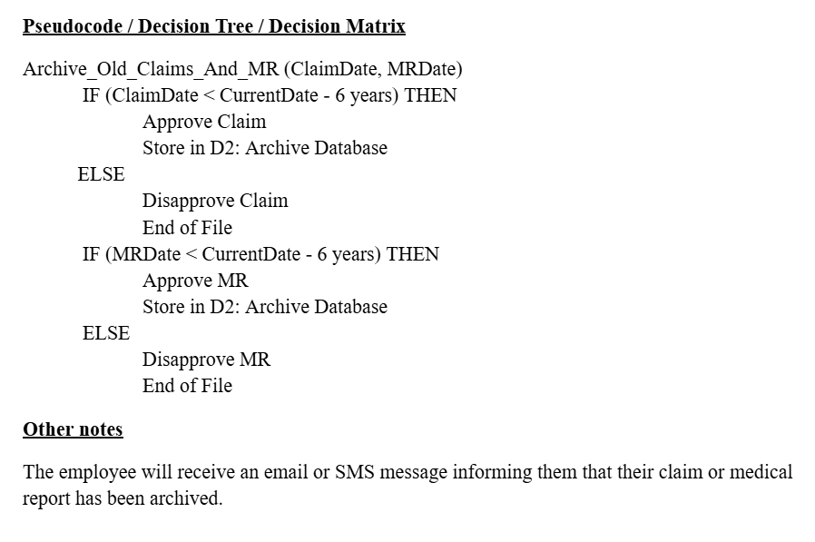

Slide 27
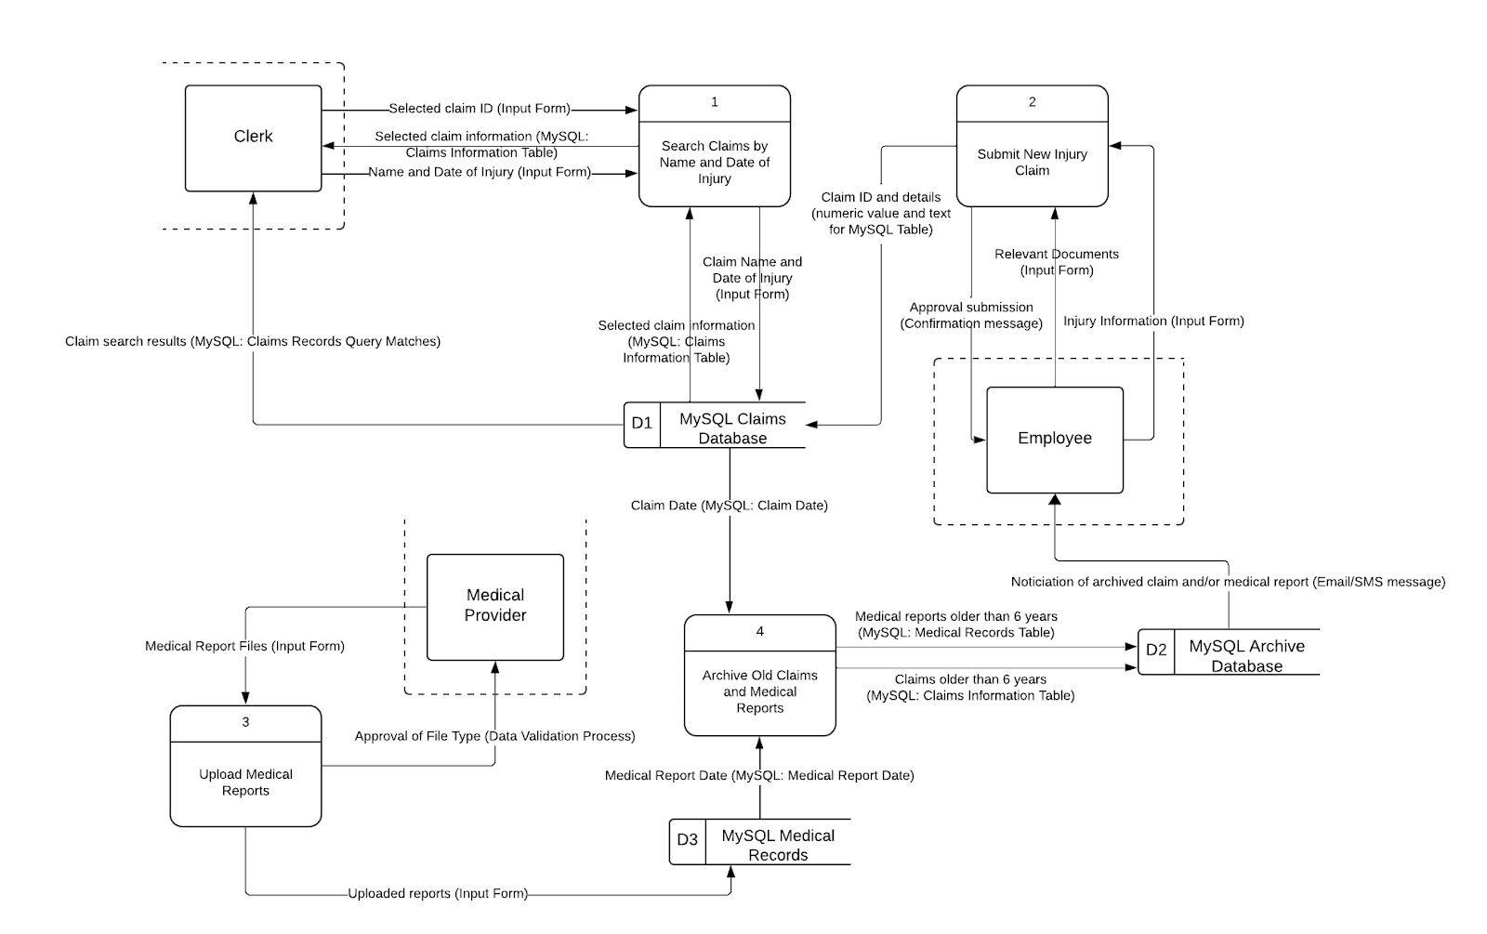
Physical DFD

Slide 28
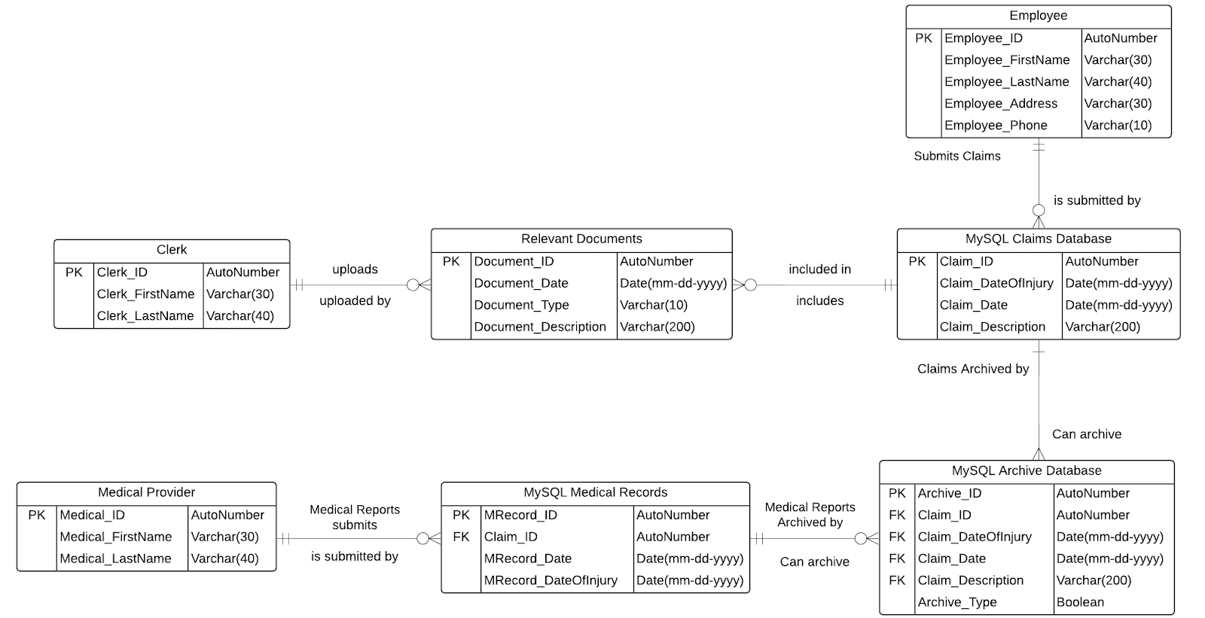
Physical ERD

Slide 29
Migration Plan
Conversion Strategy: Phased rollout — pilot, gradual department expansion, full deployment.
Business Contingency Plan: Identify risks (system failure, data issues, bugs, hardware problems) with clear response strategies, including parallel systems, rollback options, and a crisis team.
Technology Preparation:
Install and test hardware (servers, workstations, networks).
Deploy software (databases, security, applications) with system validation.
Data Migration: Audit, cleanse, and migrate data in stages, with post-migration validation.
Policy & Process Updates:
Revise access, security, and performance policies.
Align employee incentives with adoption.
Cost & Benefit Analysis: ROI: 75%, Payback: 3.64 years
Adoption & Engagement: Identify champions, incentivize users, address resistance, and engage organizational leaders to promote system benefits.

Slide 30
Training Plan
User Group | Topics | Training Dates | Format | Duration | Location/Platform
Clerks | System navigation, data handling and security awareness with HIPAA compliance. | May 5–7, 2025 | In-person workshop + videos | 3 days (2 hrs/day) | SD Dept. of Labor HQ
Medical Providers | MFA, MR uploads, API integration, submission tracking, encryption, and error resolution | May 8–9, 2025 | Live webinars + e-learning | 2 days (1 hr/day) | Department Learning Portal
IT/Admin Staff | Covers user management, DB monitoring, audit trails, backup, incident response, HIPAA, and integration with external systems. | May 12–14, 2025 | On-site technical workshop | 3 days (3 hrs/day) | IT Training Lab
Refresher for All | overall | May 20, 2025 | Virtual open Q&A session | 1 day (1 hr) | Zoom (invite via email)

Slide 31
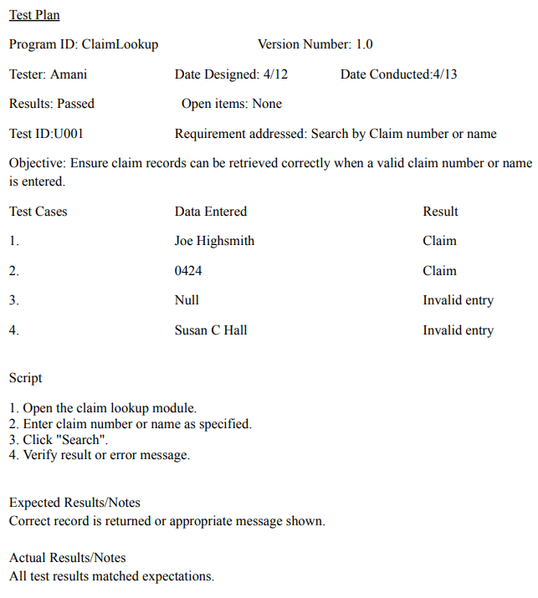
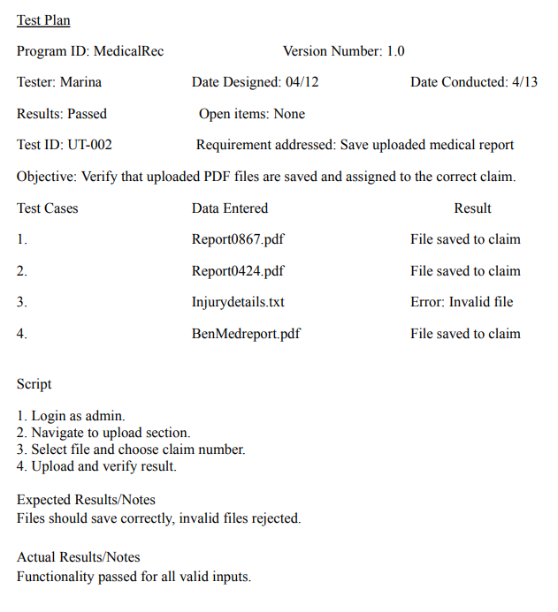
Unit Tests

Slide 32
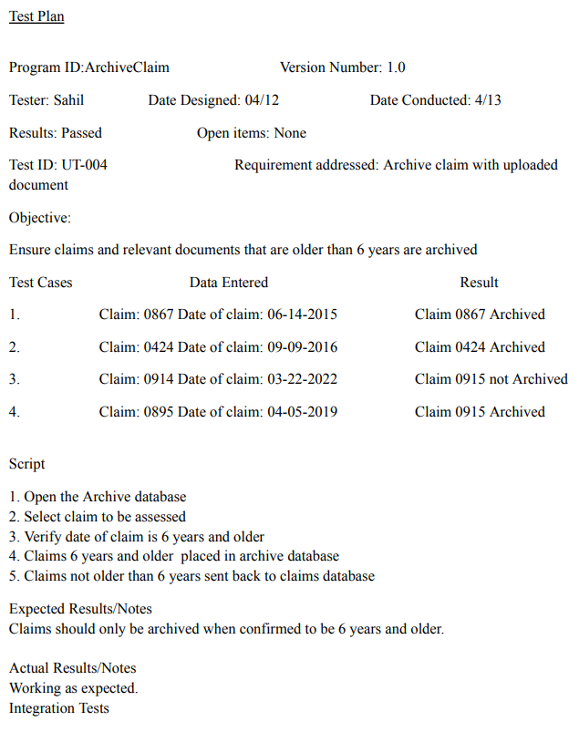
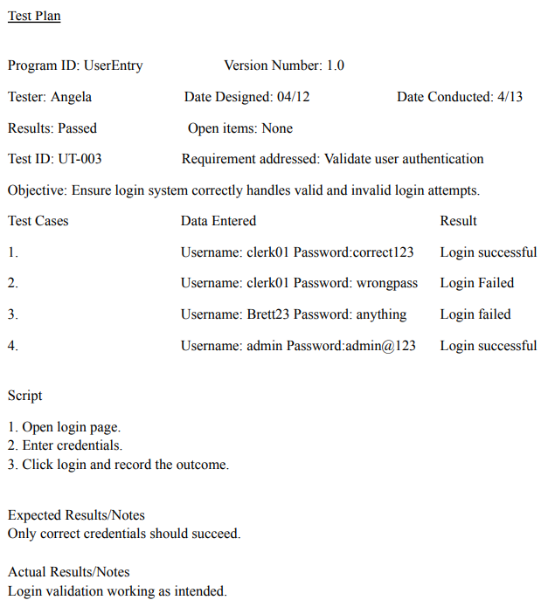

Slide 33
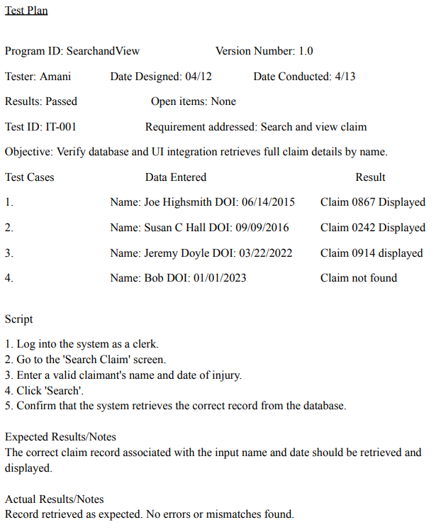
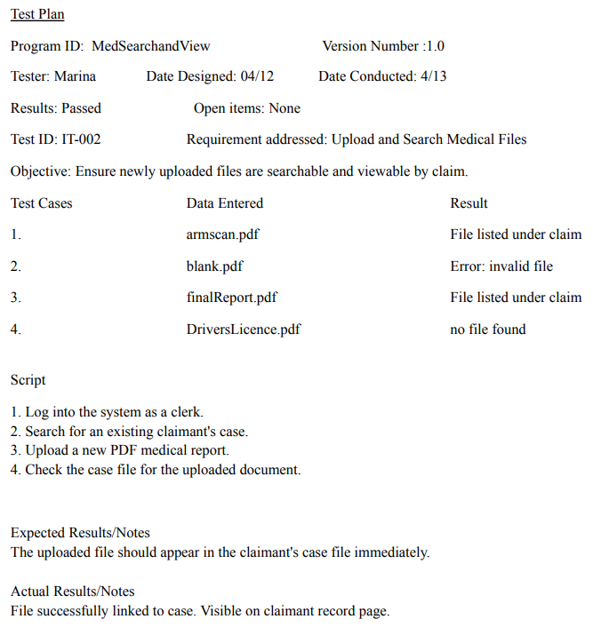
Integration Tests

Slide 34
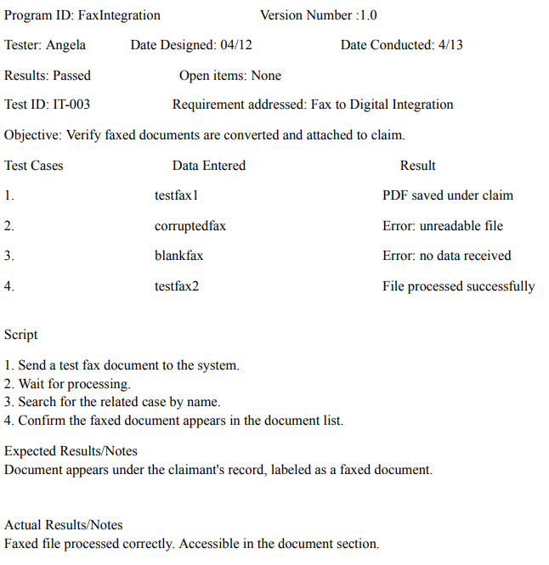
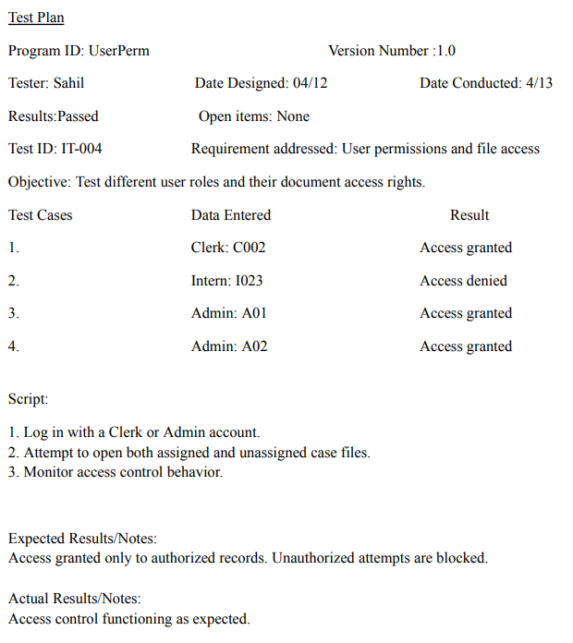

Slide 35
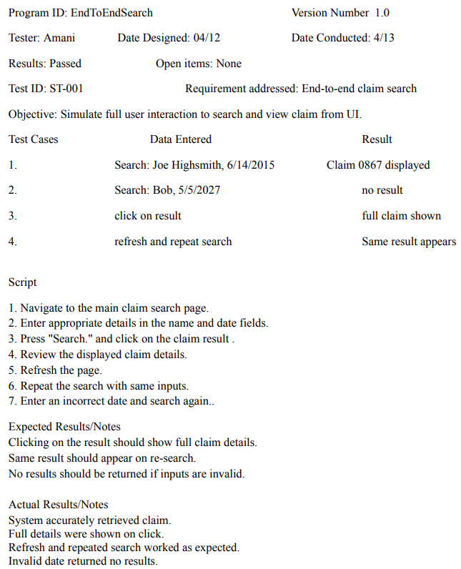
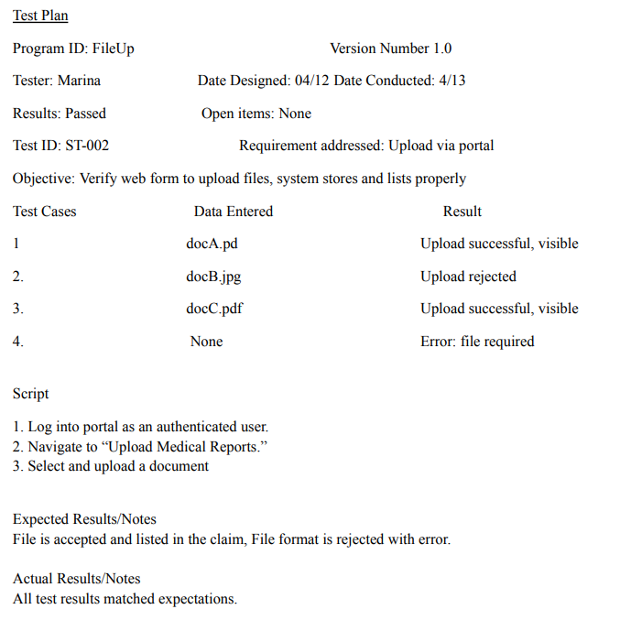
System Tests

Slide 36
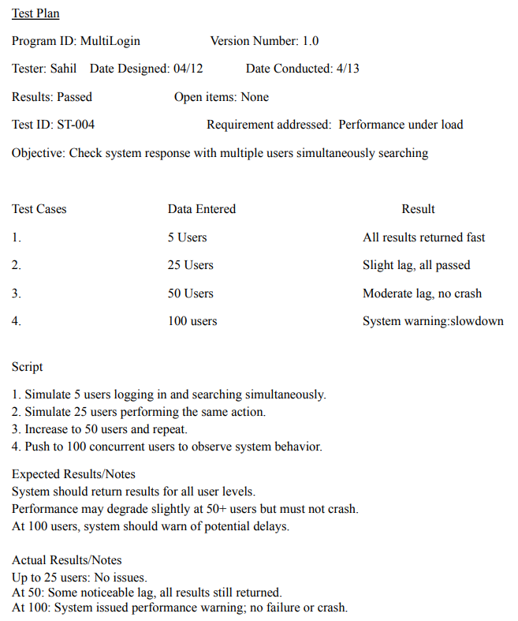
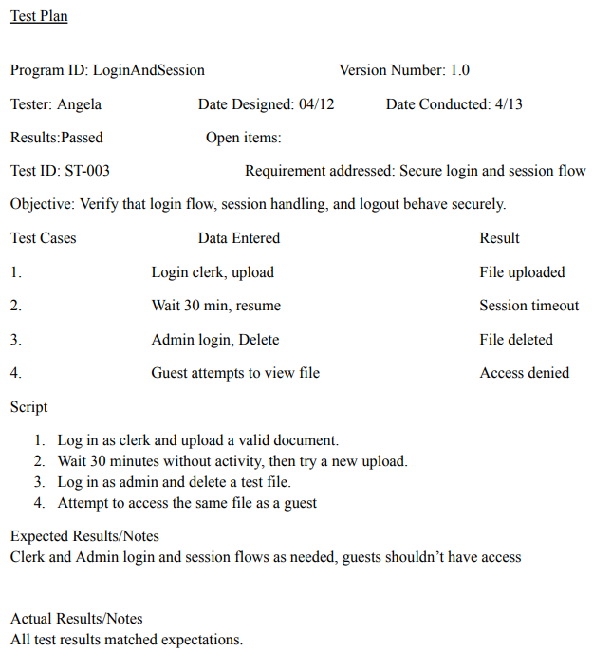

Slide 37
System Support & Maintenance
System Monitoring
Continuous monitoring for performance & security.
Automated error & security logs to detect issues and track trends.
User Support
Help Desk with Level 1 (general issues, 80% first-contact resolution)& Level 2 (complex, escalated issues).
Maintenance
Ongoing updates from issue reports & user feedback.
Scheduled: 6 PM–12 AM, 1st Tuesday monthly (patches, audits, tests).Urgent updates with advance notice.
All changes logged with release notes.

Slide 38
References
BItTitan. (2025, April 8). Migration Planning & Strategy Guide. Bittitan help center. https://help.bittitan.com/hc/en-us/articles/360044417394-Migration-Planning-Strategy-Guide
Dennis, A., Wixom, B. H., & Roth, R. M. (2022). Systems analysis and design. John Wiley & Sons, Inc.
Dam, R. F. and Teo, Y. S. (2024, February 8). Personas – A Simple Introduction. Interaction Design Foundation - IxDF. https://www.interaction-design.org/literature/article/personas-why-and-how-you-should-use-them
John. (2020, November 24). Network Firewall vs network switch VS network router: FS Community. Knowledge. https://community.fs.com/article/network-switch-router-firewall-why-need-all-three.html
Katz, T., Wheatcraft, L., & Ryan, M. (2024, November 25). System requirements definition. Guide to the System Engineering Body of Knowledge. https://sebokwiki.org/wiki/System_Requirements_Definition
Lucidchart. (n.d.). Logical vs. physical data flow diagram. https://www.lucidchart.com/pages/data-flow-diagram/logical-vs-physical-data-flow-diagram#:~:text=A%20current%20physical%20DFD%20depicts,code%20that%20fuels%20the%20requirements.
Singal, S. K., Goel, V., Nautiyal, H., & Papantonis, D. E. (2023). Economic feasibility. Economic Feasibility - an overview | ScienceDirect Topics. https://www.sciencedirect.com/topics/engineering/economic-feasibility
Suszterova, Sandra. (March 7, 2024). Physical Data Model vs. Logical Data Model. GoodData. https://www.gooddata.com/blog/physical-vs-logical-data-model/
Watson, R. (2013). Information Systems. Retrieved from http://solr.bccampus.ca:8001/bcc/file/5f0cf1f4-2c31-4424-804e-e8d57075a5fe/1/Information%20Systems.pdf

